Slide 1



《Modeling and Analysis of system》
—Safety Critical Systems
chenbo2008@ustc.edu.cn

Slide 2
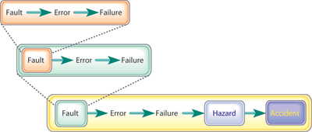
What is a Safety-critical System?
Faults are defects or situations that can lead to failures.
Failure is a situation in which a system (or part of a system) is not performing its intended function.
Hazard is a set of conditions and/or events that leads to an accident.
Accident is a loss of some kind, such as injury, death, or equipment damage
Risk is a combination of the likelihood of an accident and its severity: risk = p(a) * s(a)

Slide 3
What is a Real-Time System?
Real-time systems have been defined as: "those systems in which the correctness of the system depends not only on the logical result of the computation, but also on the time at which the results are produced";
  J. Stankovic, "Misconceptions About Real-Time Computing," IEEE Computer, 21(10), October 1988.

Slide 4
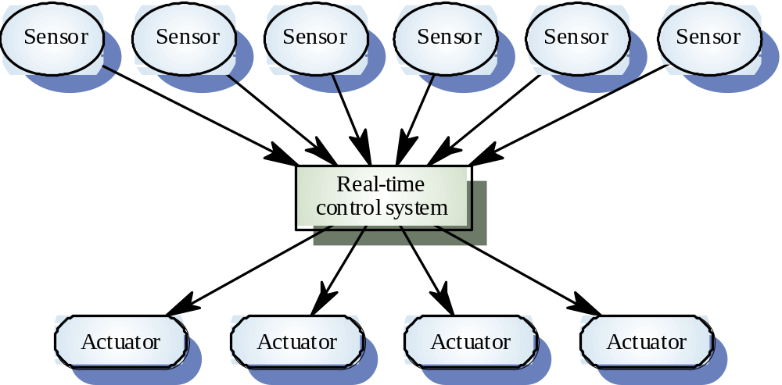
A real-time system model

Slide 5
Terms and concepts
Real time sysetm: is one that has performance deadlines on the computations and actions. real time systems are often emebdded. Meaning that the comptuational system exists inside a larger system, with the purpose of helping that system to achieve its overall responsibilities.
reactive or event-driven sysetm: is one whose behavior is primarily caused by specific reactions to external events rather than being self-generated.
time-driven systems: is one whose actions are driven primarily by either the passage of time or the arrival of time epochs.

Slide 6
Reactive or event-driven sysetm
Globally declare the counter K and the integer T.
OnKeyEnter(character C)
{
  convert C to a number N;
  if K is zero store N in T and increment K;
  otherwise add N to T, print the result and reset K to zero;
}

Slide 7
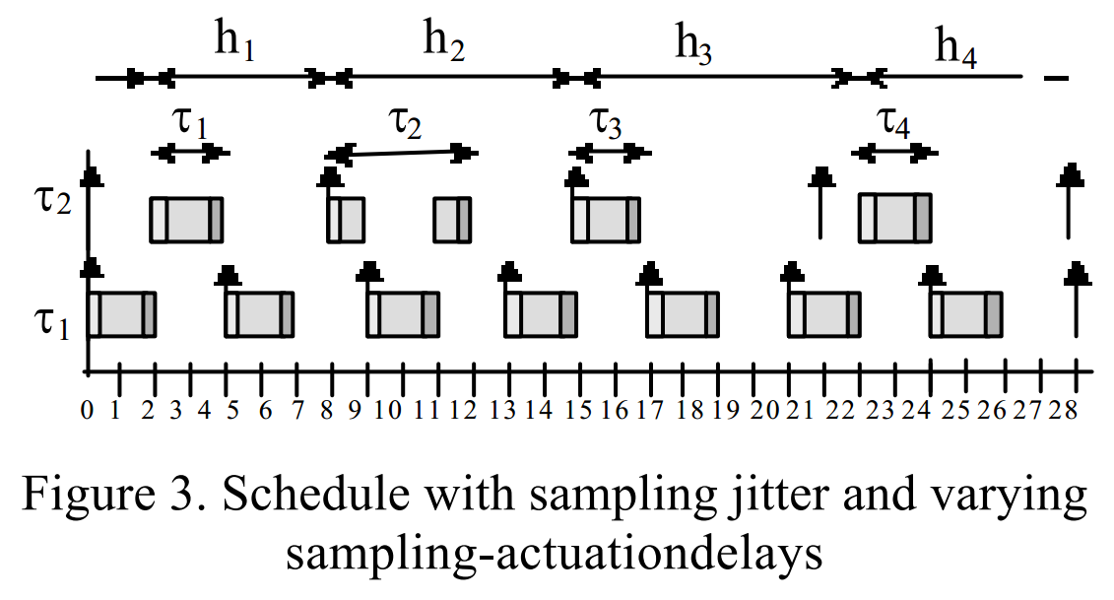
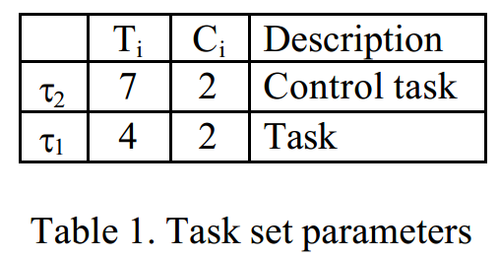
Reactive or event-driven sysetm

Slide 8
Some Definitions
Timing constraint: constraint imposed on timing behavior of a job: hard or soft.
Release Time: Instant of time job becomes available for execution. If all jobs are released when the system begins execution, then there is said to be no release time
Deadline: Instant of time a job's execution is required to be completed. If deadline is infinity, then job has no deadline. Absolute deadline is equal to release time plus relative deadline
Response time: Length of time from release time to instant job completes.

Slide 9
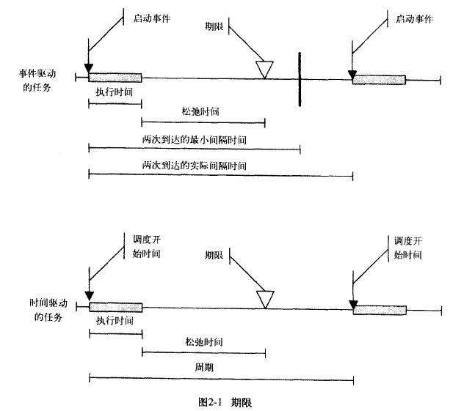
Terms and concepts

Slide 10
Timeliness
The timeliness of an action has to do with the action meeting time constraints, such as a deadline. deadline maybe hard or soft. Missing a hard deadline constitutes a system failure of some kind, so great care must be taken to ensure that all such actions execute in a timely way. The important modeling concerns of timeliness are modeling execution time, deadlines, arrival patterns, synchronization pattern and time sources.

Slide 11
Timeliness
Timeliness requirements may be addressed by first determining the end-to-end performance requirement of an event-response action sequence. these are usually determined during use case or context analysis.for example:
"When the actor Volumecontrol sens an increase command. the system shall responsed within 10 ms +/- ms"

Slide 12
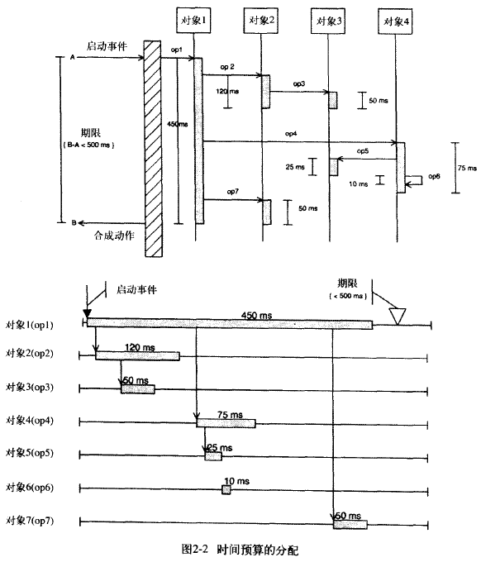
Timeliness

Slide 13
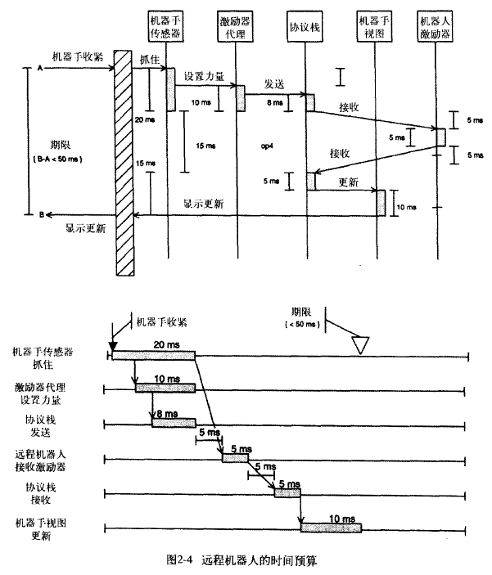
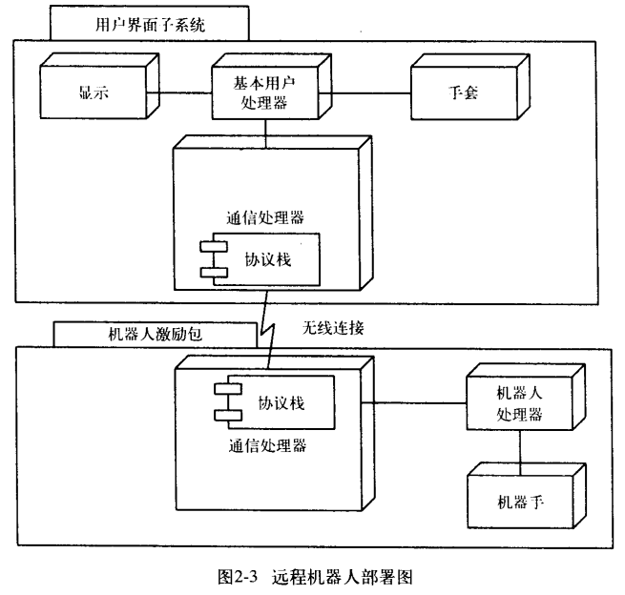
Timeliness
Remote RobotArm：

Slide 14
Concurrency
Concurrency is the simultaneous execution of multiple sequential chains of actions. These action chains may execute on one processor(pseudo-concurrency) or multiple processors(true concurrency).Issues surrounding the exectuion of concurrent systems have to do with :
  the scheduling characteristics of the concurrent thread;
  the arrival patterns of incoming events;
  the rendezvous patterns used when threads must synchronize;
  and the methods of controlling access to shared resources.

Slide 15
Predictability
A key aspect of many real time systems is their predicatbility.

Slide 16
correctness and robustness
A system is correct when it does the right thing all the time. Such a system is robust when it does the right thing under novel(unplanned) circumstances, even in the presence of unplanned failures of portions of the system. one must be on guard for deadlock, race condition, and other exceptional conditions.

Slide 17
correctness and robustness-deadlock
there are four conditions that must be true for deadlock:
  task claim exclusive control over shared resources.
  task hold resources while waiting for other resource to be relesed.
  task connot be forced to relinquish resources.
  A circular waiting condition exists.

Slide 18
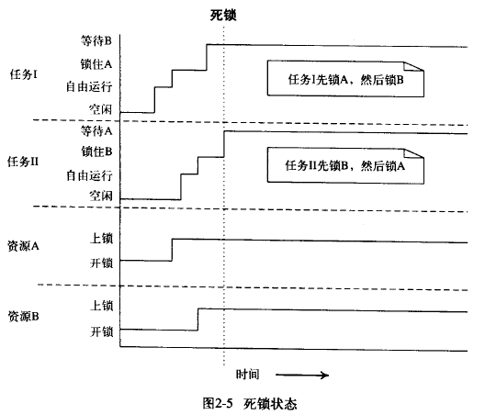
correctness and robustness-deadlock

Slide 19
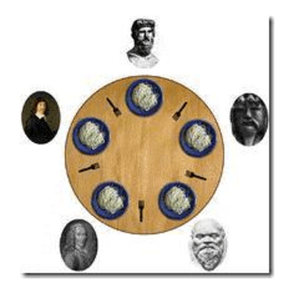
correctness and robustness-deadlock
哲学家餐桌问题
有五个哲学家，他们的一生只是进行思考和进餐。哲学家们公用一张圆桌（表示没有主席，也没有特权），周围放有五张椅子，每人坐一张。在圆桌上有五个碗和五只筷子，当一个哲学家思考时，他不与其他人交谈，饥饿时便试图取用其左、右最靠近他的筷子，但他可能一只都拿不到。只有在他拿到两只筷子时，方能进餐，进餐完后，放下左、右筷子又继续思考。
请设计一个程序使得哲学家们能够协调地使用筷子进餐，要防止其死锁。

Slide 20
correctness and robustness-deadlock
利用信号量机制解决哲学家进餐问题
用一个信号量chopstick表示一只筷子，这五个信号量构成信号量数组，其描述为：chopstick[i]。所有信号量被初始化1，第i个哲学家的活动可描述为。
typedef int semaphore； //定义信号量
semaphore chopstick[5]={1，1，1，1，1}； //初始化信号量
void philosopher(int i) //第i个哲学家的程序
{
while(1){
Thinking（）；
P(chopstick[i])；
P(chopstick[(i+1) % 5])；
Eating（）；
V(chopstick[i])；
V(chopstick[(i+1) % 5])；
}
虽然上述解法可保证不会有两个相邻的哲学家同时抓住一只筷子，但可能引起死锁。假如五个哲学家同时饥饿而拿起各自左边的筷子，使五个信号量chopstick均为0；当他们再试图去拿右边筷子时，他们都将无限期地等待。对于上述死锁问题，可采取几种解决方法解决。

Slide 21
correctness and robustness-deadlock
至多只允许四个哲学家同时进餐，以保证至少有一个哲学家可以获得二只筷子，可以进餐，最终总会释放出他所用过的两只筷子，从而可使更多的哲学家进餐。
另一种解决方法，同时只允许一位哲学家拿筷子：规定奇数号哲学家先拿起其左边筷子，然后再去拿右边筷子；而偶数号哲学家则相反。按此规定，1，2号哲学家竞争1号筷子，3，4号哲学家竞争3号筷子，即五个哲学家都先竞争奇数号筷子，获得后，再去竞争偶数号筷子，最后总会有某一个哲学家能获得两支筷子而进餐。

Slide 22
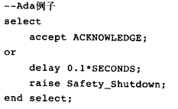
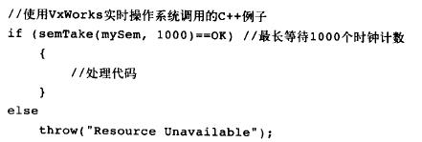
correctness and robustness-deadlock
Another way to negate condition 4 is to use a timed rendezvous. this is usually done a timed mutex from an RTOS, OR a timed entry call in Ada, as follow:

Slide 23
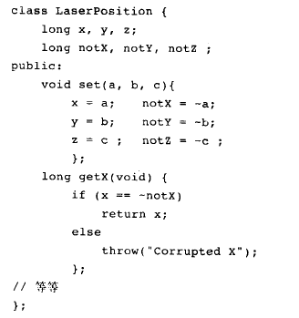
correctness and robustness-Exceptional Conditions
A robust system is one that continues todo the right thing even in the presence of system faults.

Slide 24
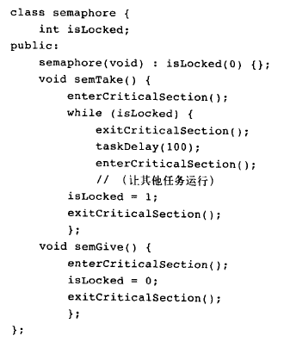
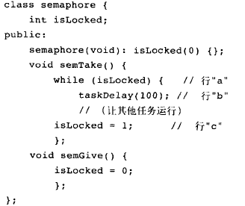
correctness and robustness-race conditions

Slide 25
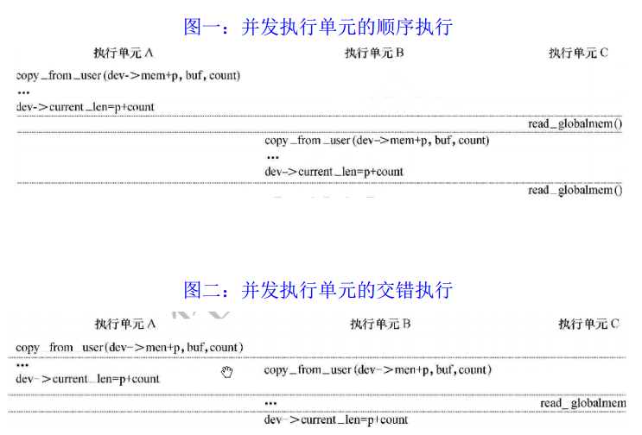
correctness and robustness-race conditions

Slide 26
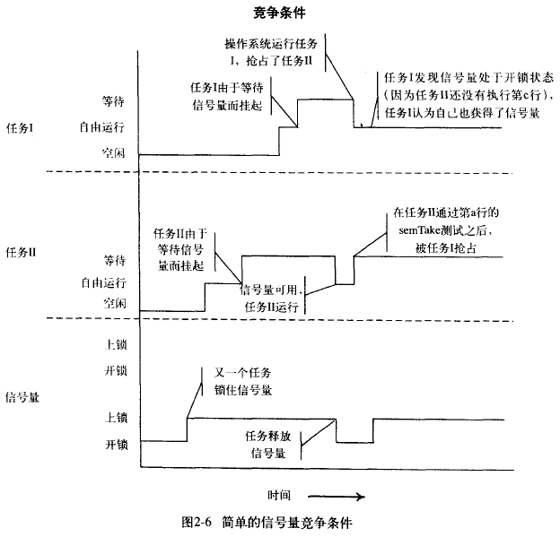
correctness and robustness-race conditions

Slide 27
Modeling Actions and Concurrency
The two types of time constraints commonly used are hard and soft:
Hard: failure to meet constraint is a fatal fault. Validation system always meets timing constraints.
  Deterministic constraints
  Probabilistic constraints
  Constraints in terms of some usefulness function.

Slide 28
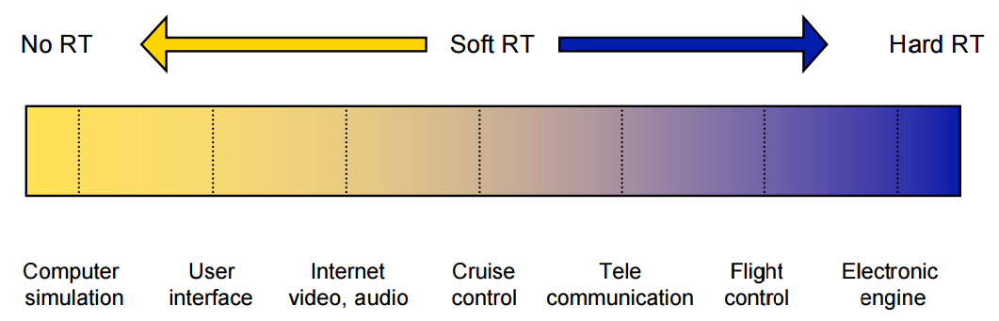
Modeling Actions and Concurrency
The two types of time constraints commonly used are hard and soft:
Soft: late completion is undesirable but generally not fatal. No validation or only demonstration job meets some statistical constraint. Occasional missed deadlines or aborted execution is usually considered tolerable. Often specified in probabilistic terms

Slide 29
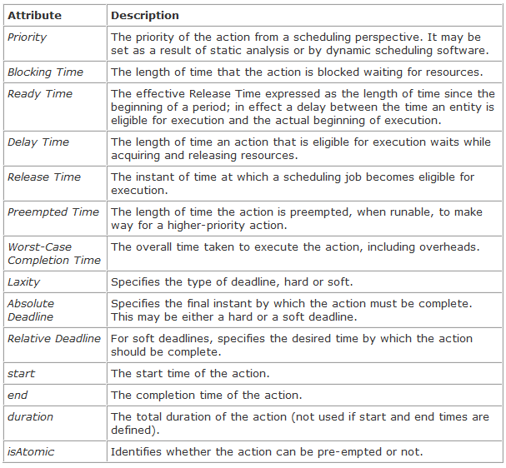
Modeling Actions and Concurrency
In the real-time profile, actions may have the time-related properties shown in :

Slide 30
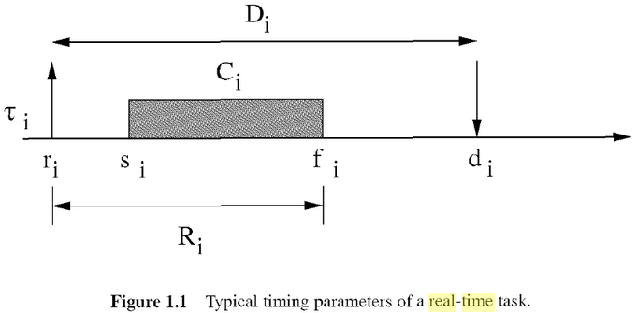
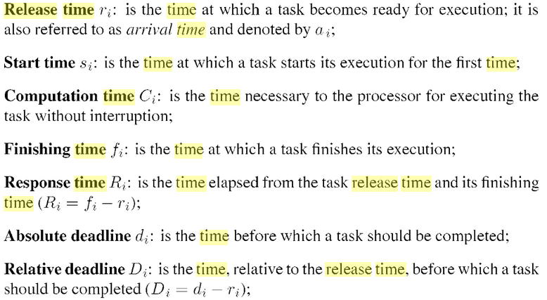
Modeling Actions and Concurrency
In the real-time profile, actions may have the time-related properties shown in

Slide 31
Modeling Actions and Concurrency
Actions are ultimately initiated by events associated with the reception of messages arising from objects outside the scope of the system. These messages have various arrival patterns that govern how the various instances of the messages arrive over time. The two most common classifications of arrival patterns are periodic and aperiodic (i.e., episodic). Periodic messages may vary from their defined pattern in a (small) random way. This is known as jitter.

Slide 32
Modeling Actions and Concurrency
Aperiodic arrivals are further classified into bounded, bursty, irregular, and stochastic (unbounded).
  In bounded arrival times a subsequent arrival is bounded between a minimum interarrival time and a maximum interarrival time.
  A bursty message arrival pattern indicates that the messages tend to clump together in time (statistically speaking, there is a positive correlation in time between the arrival of one message and the near arrival of the next). Bursty arrival patterns are characterized by a maximum burst length occurring within a specified burst interval. For example, a bouncy button might be characterized as giving up to 10 events within a 20ms burst interval. The maximum burst length is also sometimes specified with a probability density function (PDF) giving a likely distribution or frequency within the burst interval.
  Lastly, if the events arrivals are truly uncorrelated with each other, they may be modeled as arising randomly from a probability density function (PDF). This is the stochastic arrival pattern.

Slide 33
Modeling Actions and Concurrency
Each of these events may be processed in either a synchronous or an asynchronous fashion, leading to four fundamental synchronization patterns, as shown in Figure below. The sending of an event is synchronous if the sender waits until the message is sent before continuing and asynchronous if not. The reception of an event is synchronous if the receiver immediately processes it and asynchronous if that processing is delayed.
An example of synch-synch pattern (synchronous send–synchronous receive) is a standard function or operation call. A message sent and received through a TCP/IP protocol stack is an example of an asynch-asynch transfer, because the message is typically queued to send and then queued during reception as well. A remote procedure call (RPC) is an example of a synch-asynch pattern; the sender waits until the receiver is ready and processes the message (and returns a result), but the receiver may not be ready when the message is sent.

Slide 34
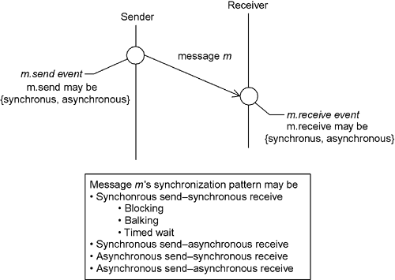
Modeling Actions and Concurrency
wait(forever if need be ) until the receiver acdepts
aborts the message if the receiver not ready
waits for a specify duration before ready received

Slide 35
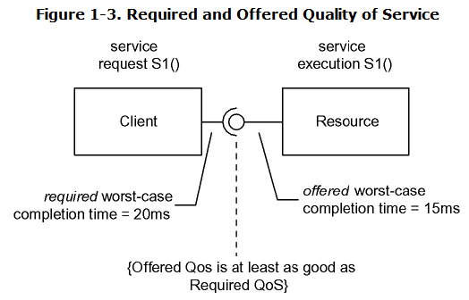
Modeling Resources
A simple analysis of execution times is usually inadequate to determine schedulability (the ability of an action to always meet its timing constraints). Most timeliness analysis is based, explicitly or implicitly, on a client-resource model in which a client requires a specified QoS from a resource and a resource offers a QoS. Assuming the offered and required values are correct, schedulability analysis is primarily a job of ensuring that offered QoS is always at least as good as required.

Slide 36
Modeling Schedulability
Operating systems, of course, provide the execution engine and the policies from which we select the one(s) we want to execute.
  Scheduling policies may be stable, optimal, responsive, and/or robust.
    A stable policy is one in which, in an overload situation, it is possible to a priori predict which task(s) will miss their timeliness requirements.
    Policies may also be optimal.An optimal policy is one that can schedule a task set if it is possible for any other policy to do so.
    A responsive policy is one in which incoming events are handled in a timely way.
    Lastly, by robust, it means that the timeliness of one task is not affected by the misbehavior of another. For example, in a round robin scheduling policy, a single misbehaving task can prevent any other task in the system from running.

Slide 37
Modeling Schedulability
Many different kinds of scheduling policies are used. Scheduling policies can be divided into two categories: fair policies and priority policies.

Slide 38
Modeling Schedulability-Fair Scheduling Policies
In contrast, priority-driven policies are unfair because some tasks (those of higher priority) are scheduled preferentially to others.
Two competing concepts are importance and urgency. Importance refers to the value of a specific action's completion to correct system performance.
The urgency of an action refers to the nearness of its deadline for that action without regard to its importance.

Slide 39
Modeling Schedulability-Fair Scheduling Policies
Scheduling Policy | Description | Pros
Cyclic Executive | The scheduler runs a set of tasks (each to completion) in a never-ending cycle. Task set is fixed at startup. | Fair Very simple Highly predictable
Time-Triggered Cyclic Executive | Same as cyclic executive except that the start of a cyclic is begun in response to a time event so that the system pauses between cycles. | Fair Very simple Highly predictable Resynchronizes cycle with reference clock
Round Robin | A task, once started, runs until it voluntarily relinquishes control to the scheduler. Tasks may be spawned or killed during the run. | Fair More flexible than cyclic executive Simple
Time-Division Round Robin | A round robin in which each task, if it does not relinquish control voluntarily, is interrupted within a specified time period, called a time slice. | Fair More flexible than cyclic executive or round robin Simple Robust

Slide 40
Modeling Schedulability-Priority Scheduling Policies
Scheduling Policy | Description | Pros
Rate Monotonic Scheduling (RMS) | All tasks are assumed periodic, with their deadline at the end of the period. Priorities are assigned as design time so that tasks with the shortest periods have the highest priority. | Stable Optimal Robust
Deadline Monotonic Scheduling (DMS) | Same as RMS except it is not assumed that the deadline is at the end of the period, and priorities are assigned at design time, based on the shortness of the task's deadline. | Stable Optimal Robust
Maximum Urgency First (MUF) | Priorities are assigned at runtime when the task becomes ready to run, based on the nearness of the task deadlines—the nearer the deadline, the higher the priority. | Optimal Scales up better than RMS or DMS Robust
Earliest Deadline Scheduling (EDS) | Laxity is defined to be the time-to-deadline minus the remaining task-execution-time. LL scheduling assigns higher priorities to lower laxity values. | Robust Optimal

Slide 41
Modeling Schedulability-Priority Scheduling Policies
Scheduling Policy | Description | Pros
Least Laxity (LL) | MUF is a hybrid of LL and RMS. A critical task set is run using the highest set of priorities under an RMS schedule, and the remaining (less critical) tasks run at lower priorities, scheduled using LL. | Robust Optimal

Slide 42
Modeling Schedulability-Importance-Weighted Priority
Equation 1-1 Importance-Weighted Priority
[DISEQ]p_{j} = W_{j} /C_{j}
Where p_{j} is the priority of task j, w_{j} is some measure of the importance of the completion of the task, and C_{j} is the period of task j. provides a reasonably rigorous treatment of weighted scheduling policies for generalized scheduling algorithms. Note that some operating systems use ascending priority values to indicate higher priority while others use descending priorities to indicate higher priority.

Slide 43

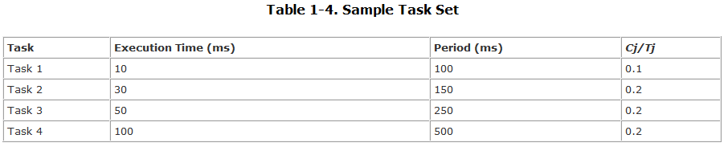
Modeling Schedulability
Equation 1-2 Basic Rate Monotonic Analysis
The sum of the utilizations from the table is 0.7. The utilization bound for four tasks is 0.757; therefore, we can guarantee that this set of tasks will always meet its deadlines.

Slide 44
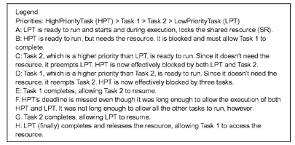
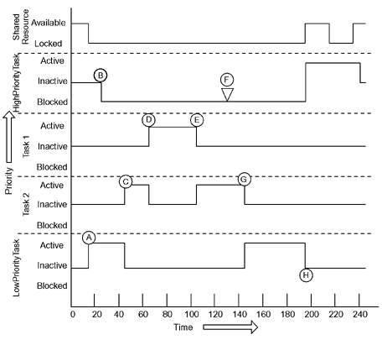
Modeling Schedulability
Priority Inversion Model

Slide 45
Real-time operating systems
Three key requirements
1. Predictable OS timing behavior
  upper bound on the execution time of OS services
  short times during which interrupts are disabled,
2. OS must be fast
3. OS must manage the timing and scheduling
  OS possibly has to be aware of task deadlines; (unless scheduling is done off-line).
  OS must provide precise time services with high resolution.

Slide 46
《Modeling and Analysis of system》
—Real-Time schedule algorithms

Slide 47
  Fixed-priority algorithm (RM)
  Dynamic-priority algorithm (EDF)

Slide 48
Real-time workload
Job (unit of work)
  a computation, a file read, a message transmission, etc
Attributes
  Resources required to make progress
  Timing parameters
Absolute deadline
Released
Execution time
Relative deadline

Slide 49
Real-time task
Task : It starts with reading of input data and of its internal state and terminates with the production of the results and updates internal state.
A task that does not have an internal state at its point of invocation is called a stateless task, otherwise, it is called a statefull task.

Slide 50
Real-time task
Task : a sequence of similar jobs
  Periodic task (p,e)
    Its jobs repeat regularly
    Period p = inter-release time (0 < p)
    Execution time e = maximum execution time (0 < e < p)
    Utilization U = e/p
0
5
10
15

Slide 51
Deadlines: Hard vs. Soft
Hard deadline
  Disastrous or very serious consequences may occur if the deadline is missed
  Validation is essential : can all the deadlines be met, even under worst-case scenario?
  Deterministic guarantees
Soft deadline
  Ideally, the deadline should be met for maximum performance. The performance degrades in case of deadline misses.
  Best effort approaches / statistical guarantees

Slide 52
Schedulability
Property indicating whether a real-time system (a set of real-time tasks) can meet their deadlines
(4,1)
(5,2)
(7,2)

Slide 53
Real-Time Scheduling
Determines the order of real-time task executions
Static-priority scheduling
Dynamic-priority scheduling
(4,1)
(5,2)
5
10
15
(7,2)
5
10
15
October 3, 2005
CIS 700

Slide 54
RM (Rate Monotonic)
Optimal static-priority scheduling
It assigns priority according to period
A task with a shorter period has a higher priority
Executes a job with the shortest period
T₁
(4,1)
T₂
(5,2)
5
10
15
T₃
(7,2)
5
10
15
October 3, 2005
CIS 700

Slide 55
RM (Rate Monotonic)
Executes a job with the shortest period
T₁
(4,1)
T₂
(5,2)
5
10
15
T₃
(7,2)
5
10
15
October 3, 2005
CIS 700

Slide 56
RM (Rate Monotonic)
Executes a job with the shortest period
The original Rate Monotonic approach had several restrictions:
all tasks are independent of each other(e.g. they do not interact)
all tasks are periodic
no task can block waiting for an external event.
all tasks share a common release time(caled the critical instant)
all tasks have a deadline equal to their period.
Deadline Miss !
T₁
(4,1)
T₂
(5,2)
5
10
15
T₃
(7,2)
5
10
15
October 3, 2005
CIS 700

Slide 57
Response Time
The original Rate Monotonic approach had several restrictions:
all tasks are independent of each other(e.g. they do not interact)
all tasks are periodic
no task can block waiting for an external event.
all tasks share a common release time(caled the critical instant)
all tasks have a deadline equal to their period.
Response time
  Duration from released time to finish time
T₁
(4,1)
T₂
(5,2)
5
10
15
T₃
(10,2)
5
10
15
October 3, 2005
CIS 700

Slide 58
Response Time
The original Rate Monotonic approach had several restrictions:
all tasks are independent of each other(e.g. they do not interact)
all tasks are periodic
no task can block waiting for an external event.
all tasks share a common release time(caled the critical instant)
all tasks have a deadline equal to their period.
Response time
  Duration from released time to finish time
Response Time
T₁
(4,1)
T₂
(5,2)
5
10
15
T₃
(10,2)
5
10
15
October 3, 2005
CIS 700

Slide 59
RM – Utilization Bound
Real-time system is schedulable under RM if
∑U_{i} ≤ n (2^{1/n}-1)
Example: T1(4,1), T2(5,1), T3(10,1),
∑Ui = 1/4 + 1/5 + 1/10
= 0.55
3 (2^{1/3}-1) ≈ 0.78
Thus, {T1, T2, T3} is schedulable under RM.
October 3, 2005
CIS 700

Slide 60
EDF (Earliest Deadline First)
Optimal dynamic priority scheduling
A task with a shorter deadline has a higher priority
Executes a job with the earliest deadline
T₁
(4,1)
T₂
(5,2)
5
10
15
T₃
(7,2)
5
10
15
October 3, 2005
CIS 700

Slide 61
EDF (Earliest Deadline First)
Executes a job with the earliest deadline
T₁
(4,1)
T₂
(5,2)
5
10
15
T₃
(7,2)
5
10
15
October 3, 2005
CIS 700

Slide 62
EDF (Earliest Deadline First)
Executes a job with the earliest deadline
T₁
(4,1)
T₂
(5,2)
5
10
15
T₃
(7,2)
5
10
15
October 3, 2005
CIS 700

Slide 63
EDF (Earliest Deadline First)
Executes a job with the earliest deadline
T₁
(4,1)
T₂
(5,2)
5
10
15
T₃
(7,2)
5
10
15
October 3, 2005
CIS 700

Slide 64
EDF (Earliest Deadline First)
Optimal scheduling algorithm
  if there is a schedule for a set of real-time tasks,
  EDF can schedule it.
T₁
(4,1)
T₂
(5,2)
5
10
15
T₃
(7,2)
5
10
15
October 3, 2005
CIS 700

Slide 65
EDF – Utilization Bound
Real-time system is schedulable under EDF if and only if
∑U_{i} ≤ 1
Liu & Layland,
“Scheduling algorithms for multi-programming in a hard-real-time environment”, Journal of ACM, 1973
October 3, 2005
CIS 700

Slide 66
EDF – Overload Conditions
Domino effect during overload conditions
  Example: T₁(4,3), T₂(5,3), T₃(6,3), T₄(7,3)
Deadline Miss !
T₁
T₂
T₃
T₄
0
3
5
6
7
Better schedules :
T₁
T₃
T₁
T₄
0
3
5
6
7
0
3
5
6
7
October 3, 2005
CIS 700

